Slide 1

Lic. en Sistemas
Inglés Nivel 1

Slide 2


Unit 5
E-commerce

Slide 3
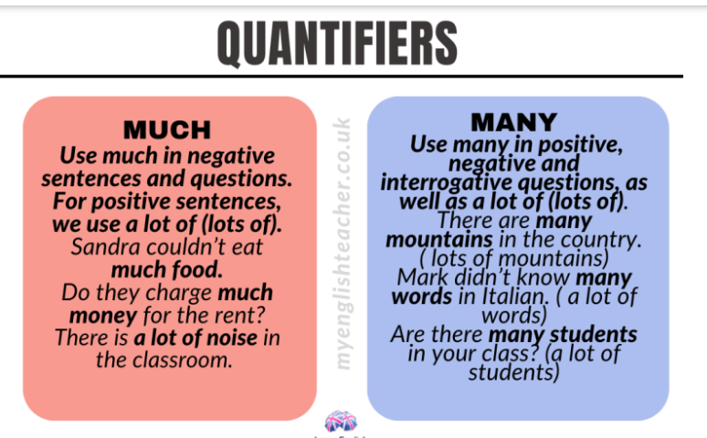

Slide 4


Slide 5
Much, many, a lot of (lots of)
Both much and many mean a large quantity of something. We use much with uncountable and many with countable nouns.
much icecream, much time, much money, much energy
many people, many countries, many species
We normally use much in negative sentences and questions. For positive sentences, we use a lot of (lots of).
Sandra couldn’t eat much food.
Do they charge much money for the rent?
There is a lot of noise in the classroom.

Slide 6
Much, many, a lot of (lots of)
However, we can use too much, so much, as much in positive sentences.
The waiter charged me too much money.
You’ll get fat if you eat so much pasta.
Take as much time as you like.
We can use many in positive, negative and interrogative questions, as well as a lot of (lots of).
There are many mountains in the country. ( lots of mountains)
Mark didn’t know many words in Italian. ( a lot of words)
Are there many students in your class? (a lot of students)

Slide 7
Much, many, a lot of (lots of)
We use a lot of (lots of) with both countable and uncountable nouns.
There was a lot of mud on his trainers.
Lots of people decide to buy electric cars nowadays.
Use the form a lot or lots at the end of a sentence or a clause.
When her pet dog died, Lucy cried a lot.
Have some more food, there is lots left.

Slide 8
(a) little and (a) few
A little refers to a small amount of something and it is used with uncountable nouns.
We have a little time, let’s go for a walk.
Jay could speak a little Chinese.
She seasoned the salad with a little oil.
A few means a small amount of something. It goes with countable nouns.
Chris stood there for a few moments.
Phoebe put a few clothes into her suitcase.
I’m trying to save a few pounds each day.

Slide 9
